Slide 1
Week 3
You’re still here?

Slide 2
Todays Plan
Administrative Stuff
Structural Changes
Submission
Homework Correction
Note to UTF8
Tutor Tasks
Syntax Trees
Flow Charts
MinMax
Pascals Triangle

Slide 3
Administrative

Slide 4
Administrative – Structural Changes
Time | Beginners | Experienced
15 Mins | Admin + Homework Discussion Time
30 Mins | Task 1: General non-programming skills
30 Mins | Task 2: General non-programming skills
15 Mins | General Explanation to Tasks 3 and 4 (Programming Tasks)
15 Mins | Theory Explanation Task 3 | Own Programming Time Questions can be asked during Programming Time
30 Mins | Programming Time Task 3
15 Mins | Theory Explanation Task 4
30 Mins | Programming Time Task 4

Slide 5
Admin – Submissions

Slide 6
Admin – Submissions
3 Instances in Moodle has been disabled
See your email
Submit in the Main Instance

Slide 7
Admin – Homework Correction
Thursday Afternoon I shall begin correcting
Model Solutions uploaded
Most questions have been asked in the tutor group

Slide 8
Admin – Last Week’s Homework
Any Questions?

Slide 9
Admin – UTF8

Slide 10
Admin – UTF8
Linux → To be absolutely sure use “file –bi <filename>”
Mac → Probably the same as Linux
Windows → Atom Text Editor

Slide 11
Tutor Tasks
Syntax Trees
01
Flow Charts
02
MinMax
03
Pascals Triangle
04

Slide 12
Syntax Trees

Slide 13
Syntax Trees
A lot of effort, but easy exam points

Slide 14
Syntax Trees
Grammar on Moodle

Slide 15
Syntax – Trees Demo
Sum Function
Absolute Value Function

Slide 16
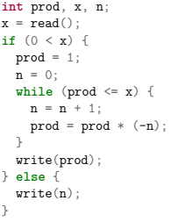
Syntax Trees – Your Turn

Slide 17
Flow Charts

Slide 18
Flow Charts – Symbols
Stop
Start
N>13
Yes
No
N = 42;

Slide 19
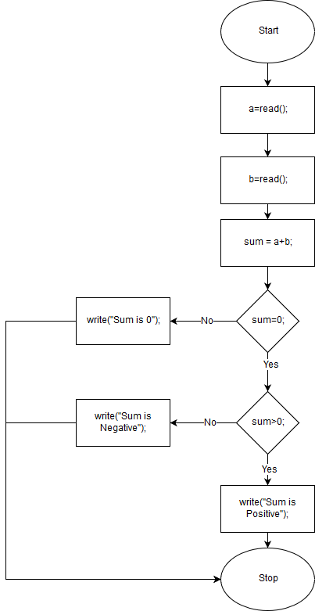
Flow Chart Example

Slide 20
Flow Chart – Site
www.draw.io

Slide 21
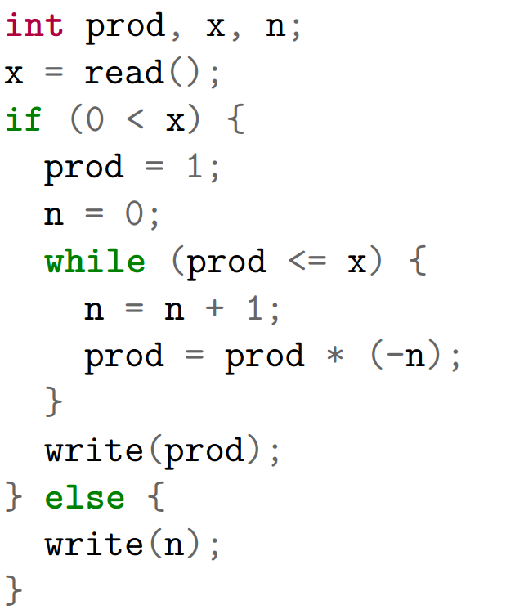
Flow Chart Code

Slide 22
Min-Max

Slide 23
MinMax – Arrays
Essentially an Array is a list of Objects of a certain type

Slide 24
MinMax – Declaring an Array
int[] arr = new int[5] → {0, 0, 0, 0, 0}
int[] arr = {1, 2, 3, 4, 5} → {1, 2, 3, 4, 5}

Slide 25
MinMax – Usefull Array Functions
Say int[] n = new int[arrlength];
n.length() → returns arrlength

Slide 26
MinMax – Array Demo

Slide 27
MinMax – Your Task
Find the smallest and largest elements of an array

Slide 28
MinMax – Your Task
Ask user for array length
Ask user for all values
In one pass through the smallest & largest numbers should be found
Output the largest and smallest numbers

Slide 29
Pascal's Triangle

Slide 30
Pascals Triangle

Slide 31
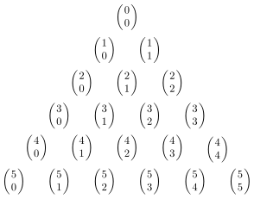
Pascals Triangle
Binomial Coefficient

Slide 32
Pascals Triangle
Binomial Coefficient n ≥ k ≥ 0
How many of you still remember how to calculate factorials?
What is 5!

Slide 33
Pascals Triangle
Binomial Coefficient n ≥ k ≥ 0
How many of you still remember how to calculate factorials?
5! = 5*4*3*2*1=120

Slide 34
Pascals Triangle
Binomial Coefficient n ≥ k ≥ 0
How many of you still remember how to calculate factorials?
5! = 5*4*3*2*1=120

Slide 35
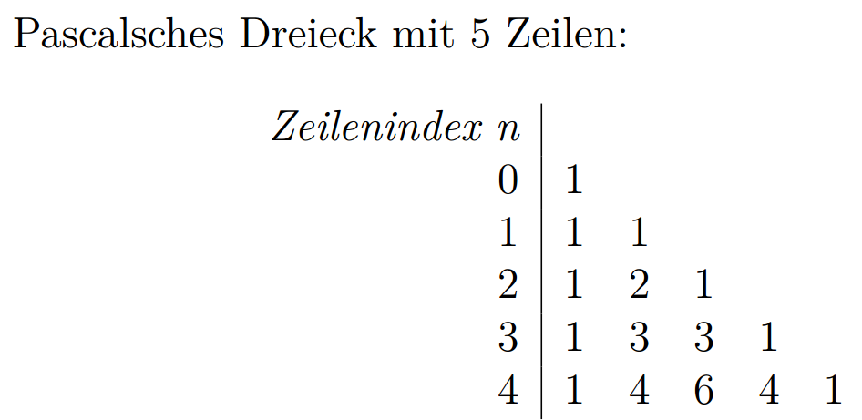
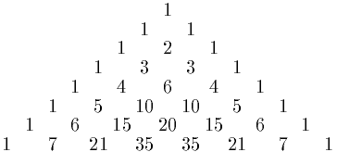
Pascals Triangle
Get a row value for n from the user
Generate pascals triangle rows from 0 to n-1 Each row shall be put into an array
Output the array in a sensible fashion

Slide 36
Pascals Triangle
Prompt the user a new input if the number is smaller than 1

Slide 37
Pascals Triangle – Tips
First and Last element of an array is always 1

