Slide 1
Week 4

Slide 2
Table of contents
Homework discussion
Useful Functions
Tutor Tasks
Number Base
Caesar Encryption
Vowel Replacing
Inverse Capitalization

Slide 3
Homework

Slide 4
Homework
Should be corrected faster next time
Please double check your scoring → late night math's doesn’t always work that well

Slide 5
homework
Any Questions to Week 3?

Slide 6
Useful Methods and classes for this week

Slide 7
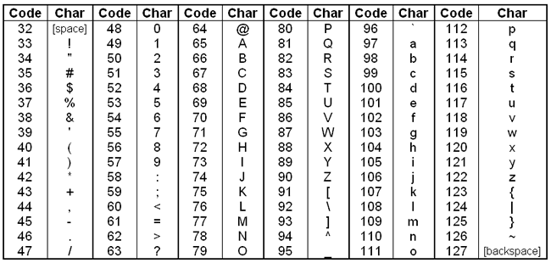
Chars
Char is a digit between 0 and 127
Each char is mapped to a letter
A string is comprised of multiple chars
‘A’ == 65
char c = 65 is equivalent to c = ‘A’

Slide 8
Useful String Methods
String s = “Demo”;
s.charAt(2); // ’m’ First Letter is Index 0
s.length(); // 4 Starts at 0 being an empty string

Slide 9
Binary Operators
These are the operators for Java
Differ in DS and ERA

Slide 10
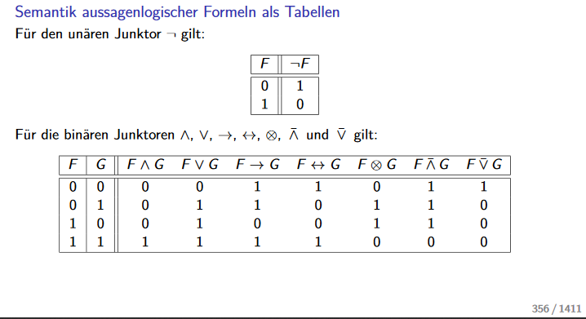
Binary Operators – Carlos DS Trainer
~F
F & G
F | G
F^G

Slide 11
Binary Operators – Practice
0010 & 1111
0000 | 1100
~1010
0011 ^ 0110

Slide 12
Binary Operators – Practice Examples
0010 & 1111 = 0010
0000 | 1100 = 1100
~1010 = 0101
0011 ^ 0110 = 0101

Slide 13
Tutor Tasks

Slide 14
Number base
Binary Base 2
Octal Base 8
Decimal Base 10
Hexadecimal Base 16

Slide 15
Number base
What numbers are valid in:
Binary

Slide 16
Number base
What numbers are valid in:
Binary (0 and 1)

Slide 17
Number base
What numbers are valid in:
Octal

Slide 18
Number base
What numbers are valid in:
Octal (0-7)

Slide 19
Number base
What numbers are valid in:
Hexadecimal

Slide 20
Number base
What numbers are valid in:
Hexadecimal (0 - F)

Slide 21
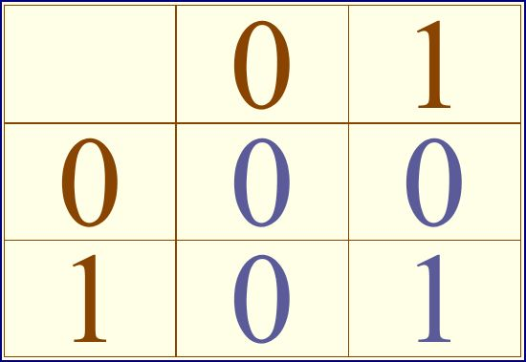
Number Base – Approach
Draw a multiplication/addition table
Binary Multiplication Table

Slide 22
Number Base – Approach
How would a binary addition table look like?

Slide 23
Number Base – Approach
Draw a Base 5 Addition and Multiplication Table

Slide 24
Number Base – Approach
Draw a Base 5 Addition and Multiplication Table
33 + 14 + 13 in Base 5
22*3 in Base 5

Slide 25
Number Base – Tasks
323478₉ + 111202337₉
1010101100₂ ∗ 11000111₂
120022₃ ∗ 22210₃

Slide 26
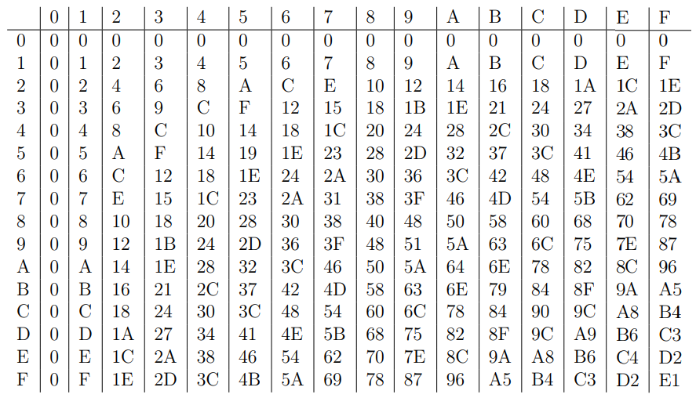
Number Base – Tasks
323478₉ + 111202337₉
1010101100₂ ∗ 11000111₂
120022₃ ∗ 22210₃
c01dc0ffe₁₆ ∗ deadaffe₁₆
Base 16 Multiplication

Slide 27
Number Base Conversion - Demo
100 in Binary
1101 1111 0b in Hexadecimal
1101 1010 1111b in Decimal

Slide 28
Number Base Conversion – Tutor Tasks
1010101100₂ in Base10
1010101100₂ in Base16
354347357₁₀ in Base 2

Slide 29
Number Base – Conversion Demo For Homework
2143 in base 5 to base 7
21432 in base 5 to base 9
Double check your solutions using Wolfram Alpha “21432_5 in base 9”

Slide 30
Caesar Encryption

Slide 31
Caesar Encryption
Only encrypts Letters, not symbols
"Hello Students! .aAbBcC? >wWxXyYzZ<“ becomes "Khoor Vwxghqwv! .dDeEfF? >zZaAbBcC<“ with a shift of 3

Slide 32
Caesar Encryption
Input a String to be encrypted
Input a cipher as an int
Can be negative or greater than 26
Encrypt the string
Case should remain the same
Output the String via write()

Slide 33
Vowel Replacement

Slide 34
Vowel Replacement
Write a program that replaces all vowels (a, e, i, o u) with a specified letter
Ä, ö, ü are not considered vowels
Must keep capitalization
Only uses length and charAt library functions
EX: "Exenmeister" to "Oxonmoostor" if O/o is inputted

Slide 35
Vowel Replacement – Approach
Use code interface provided
Input a letter to replace all vowels with
Output the new String

Slide 36
Inverse Capitalization

Slide 37
Inverse Capitalization
Read String
Swap Upper and Lower Case
Outputs via Write
Only uses length and charAt library functions
EX: "Hello Students!" to "hELLO sTUDENTS!"

Slide 38
Inverse Capitalization
Challenge for the experienced programmers:
Convert uppercase to lowercase and vice versa via binary operators
Tip: Look at the ASCII table in Binary and compare a letters uppercase and lowercase number

