Slide 1
Week 5

Slide 2
Today’s Plan
Homework
Quiz
Tutor Tasks
Order of Operations
Array Operations
Matrix and Vector Multiplication

Slide 3
Homework

Slide 4
Homework
Please refrain from using Umlauts and ß in your Programs →Causes all kinds of issues

Slide 5
Homework
Any Questions?

Slide 6
Tutor Tasks

Slide 7
Quiz

Slide 8
Bonus Question
Int I = 5;
Int J = 2;
System.out.println(I/J);

Slide 9
Bonus Question – Answer
Int I = 5;
Int J = 2;
System.out.println(I/J); → 2

Slide 10
Order of Operations

Slide 11
Order of Operations – Relevant

Slide 12
Order of Operations – Tasks
2 + 3 * 4 - 6
6 * 7 % 4
(18 - 7) * (7.2 % 5.2)
"34" + 2 * 4

Slide 13
Order of Operations – Tasks
(18 - 7) * (7.2 % 5.2)
18.0 - 7 * 9 % 10
4 / 2 * 9 / 4
813 % 100 / 3 + 2.4
"34" + 2 + 4
(double) 3 + 5 * 4 + 3 + Integer.parseInt("1") + 8

Slide 14
Custom Array Methods

Slide 15
Custom Array Methods
public static void print(int[] array)
Prints Array in format: {1, 2, 3, 4, 5}
public static int[] invert(int[] array)
{0, 1, 2, 3} becomes {3, 2, 1, 0}

Slide 16
Custom Array Methods
public static int[] cut(int[] array, int length)
cut(new int[] {1, 2, 3}, 2) becomes {1, 2}
cut(new int[] {1, 2, 3}, 5) becomes {1, 2, 3, 0, 0}
public static int[] linearize(int[][] array)
linearize(new int[][] {{1, 3}, {25}, {7, 4, 6, 9}}) becomes {1, 3, 25, 7, 4, 6, 9}

Slide 17
Matrix and Vector Operations

Slide 18
Matrix and Vector Operations
We shall assume that all Matrix Inputs are correct

Slide 19
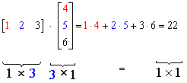
Matrix and Vector Operations
public static int vecVecMul(int[] a, int[] b)

Slide 20
Matrix and Vector Operations
public static int[] matVecMul(int[][] a, int[]b)

Slide 21
Matrix and Vector Operations
public static int[][] transpose(int[][] a)

Slide 22
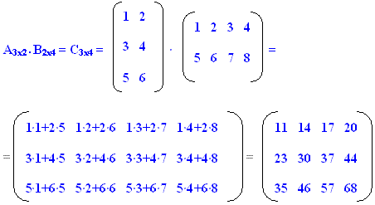
Matrix and Vector Operations
public static int[][] matMatMult(int[][] a, int[][]b)

