Slide 1
Week 7
Assembly of Tears

Slide 2
Todays Plan
Tutor Task
Factorial
Toolbox
Quicksort
Assembly

Slide 3
Tutor Tasks

Slide 4
Factorial

Slide 5
Factorial – Head vs TAIL recursion

Slide 6
Factorial – Head vs TAIL recursion
Tail Recursion: Recursion call is at the end of the method
Head Recursion: Recursion call is at the start of the method

Slide 7
Factorial – Head vs TAIL recursion
Tail Recursion: Recursion call is at the end of the method
Head Recursion: Recursion call is at the start of the method

Slide 8
Factorial – Head vs TAIL recursion
How to Remember:
Tail Recursion: Nothing comes after the tail

Slide 9
Factorial – Head vs TAIL recursion
More Reading: https://www.cs.cmu.edu/~adamchik/15-121/lectures/Recursions/recursions.html

Slide 10
Factorial
Implement factorial using
Iterative
Head Recursion
Tail Recursion
Advisable to use a help method:
private static int facTailRecHelper(int n, int k)

Slide 11
Toolbox

Slide 12
Toolbox
No loops allowed
No while
No for
Use Recursion

Slide 13
Toolbox – isEven
Boolean isEven(int n)
True if Even
False if Odd

Slide 14
Toolbox – even sum
Public static int evenSum(int n)
Sum all even numbers from n to 0 (also negatives)
F(8):= 8+6+4+2(+0) = 20
F(-8):= -8+-6+-4+-2(+-0) = -20
No *, /, % allowed
Do use isEven

Slide 15
Toolbox – Multiplication
Public static int multiplication(int x, int y)
Implement multiplication via addition recursively

Slide 16
Toolbox – Array Reversion
Public static void reverse(int[] m)
Reverse an array recursively
Without the creation of temporary arrays

Slide 17
Toolbox – Array Reversion
Public static int numberofOddIntegers(int[] m)
Count recursively how many integers are odd

Slide 18
Toolbox – Array Reversion
Public static int filterOdd(int[] m)
Create a new array with only the odd numbers
In order of the original array

Slide 19
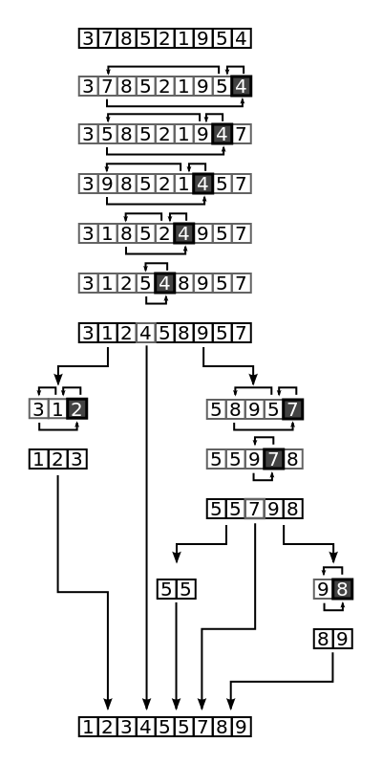
QuickSort

Slide 20
Quicksort – demo
Doing Quicksort with [5 1 3 9 1 5 3]

Slide 21
Quicksort – Implementation
Void swap(int[] numbers, int i, int j)
Int partition (int[] numbers, int left, int right)
Numbers[right] = pivot element
Array between left and right inclusive of pivot should be swapped according to quicksort
Implements Quicksort
Write a suitable main method that generates a random array
Math.random()
ran Random = new Random();
From java.util.Random

Slide 22
Assembly

Slide 23
Assembly
10 Minutes Reading time for the homework
Most details on assembly are written there

Slide 24
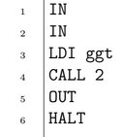
Assembly – Line By Line
In gets input via a method like Read() and is placed in the stack
A 16 Bit Address of ggt is loaded onto the stack
Call the function with the two parameters (the order of which is the stack order)
Output value at top of stack
End Program

Slide 25
Assembly – Line By Line
Function declaration
Reserves space for 1 variable (1x 16 bits)

Slide 26
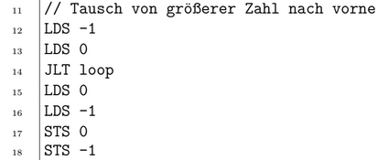
Assembly – Line By Line
Copy variable 1 into the stack
Copy variable 2 into the stack
If var1<var2 Jump to Next Step
Else
Copy Var2 into the stack
Copy Var1 into the stack
Save Var2 to Var1’s location
Save Var1 to Var2’s location

Slide 27
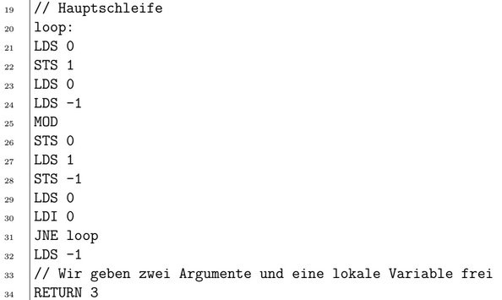
Assembly – Line By Line
Loop: Begins here
Setup for modulo operation
B = b%a
Setup for Jump Not Equal
If Not Equal, jump back to line 20
Copy the result into the stack

