Slide 1
Week 8
Tutorclass tc = new Tutorclass(“Week8”);

Slide 2
Today’s Plan
Unit Testing Demo
Object Orientated Programming Explanation
Access to Variables Demo
Immutable Set
Timetable

Slide 3
Unit Testing
Tests the Inputs and Outputs of a Function
Checks if the output is what is expected
Of course this only works on deterministic functions

Slide 4
Unit Testing
Junit Library is used

Slide 5
Unit Testing – Test Based Programming
It forces you to consider what each functions input and output is long before
Also makes you consider the interaction of edge cases
Automates Testing → Don’t have to enter everything manually

Slide 6
Unit Test
Demo

Slide 7
Object Orientated Programming
Blueprint vs Instance

Slide 8
Variable Access

Slide 9
Variable Access
Demo

Slide 10
Immutable Set
Think of it as a set of Strings
[aa, AA, bb]
Rule of Sets: All elements are unique

Slide 11
Immutable Set – Implement
Constructor – Creates a empty set
Boolean isElement(String s) – Is s included in set
Boolean superset(ImmutableSet subset) – are all elements of subset found within the current set
Boolean isEqual(ImmutableSet other) – Are all elements of other found in the current set
Void add(String s) – Append s to the set if s is not currently found in the set
String toString() – Represent the set as a String in the following format [a, b, c]

Slide 12
Immutable Set – Tests
I have written for you a unit test that will test your code
Found on my website in this weeks folder

Slide 13
Immutable Set – Implement
Constructor – Creates a empty set
Boolean isElement(String s) – Is s included in set
Boolean superset(ImmutableSet subset) – are all elements of subset found within the current set
Boolean isEqual(ImmutableSet other) – Are all elements of other found in the current set
Void add(String s) – Append s to the set if s is not currently found in the set
String toString() – Represent the set as a String in the following format [a, b, c]

Slide 14
Time Table
This is a two part task
First Implement the class Date
Then Implement the class Timetable
With a subclass DateList

Slide 15
Time Table – List Refresher
What is a list?

Slide 16
Time Table – List Refresher
What is a list?

Slide 17
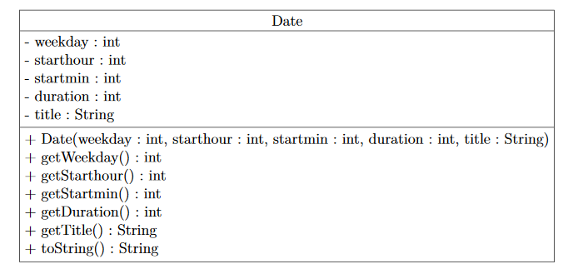
The Class Date

Slide 18
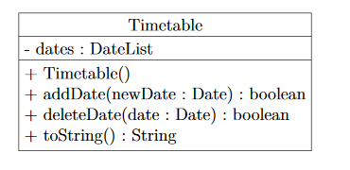
Time Table Class

Slide 19
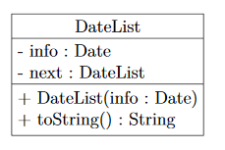
Date List Class

Slide 20
Time Table Class

