Slide 1
Week 9
Merry Christmas

Slide 2
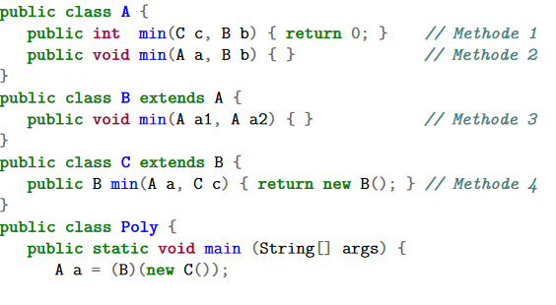
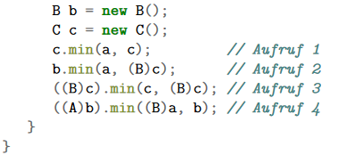
Inheritance
The static types of all the Expressions of a Method Call
Signature of the Method when it is called
What the Object evaluates to
Which Method # is called

Slide 3
Inheritance – Method 4
The static types of all the Expressions of a Method Call ABB
Signature of the Method when it is called min(B, B)
What the Object evaluates to B
Which Method # is called 2

Slide 4
Doubly Linked Lists

Slide 5
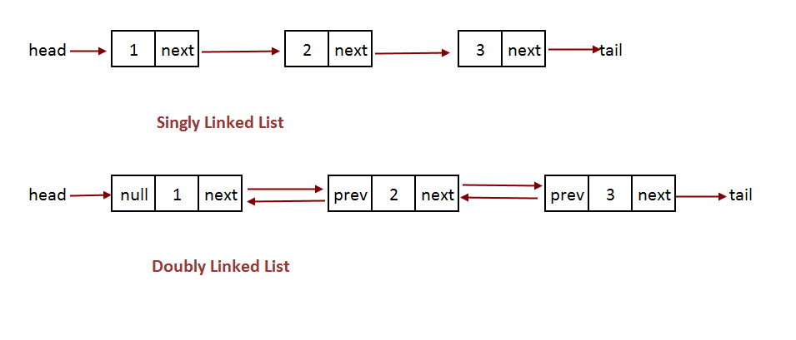
Doubly Linked Lists

Slide 6
Doubly Linked Lists

Slide 7
Doubly Linked Lists – Methods
Constructor that initializes head with NULL
Public int size() – Returns # of elems in the List
Public void add(int info) – Appends an elem to the end of the list
Public void add(int index, int info) – Make a new node that will become the $index element. If index is invalid do nothing
Publc int remove(int index) – Removes an element at $index and returns its value. If there is an invalid index, Integer.MIN_VALUE is to be returned
Public void shiftLeft(int index) – shifts all elements $index to the left. You are only allowed to change head, prev and next.
Ex: [0, 1, 2, 4] will become [2, 4, 0, 1] with shiftLeft(2)
Ex: [0, 1] will become [1, 0] with shiftLeft(1)
Shiftleft(0) does nothing

Slide 8
Doubly Linked Lists
Unit test is provided on the website

Slide 9
Doubly Linked Lists – Methods
Constructor that initializes head with NULL
Public int size() – Returns # of elems in the List
Public void add(int info) – Appends an elem to the end of the list
Public void add(int index, int info) – Make a new node that will become the $index element. If index is invalid do nothing
Publc int remove(int index) – Removes an element at $index and returns its value. If there is an invalid index, Integer.MIN_VALUE is to be returned
Public void shiftLeft(int index) – shifts all elements $index to the left. You are only allowed to change head, prev and next.
Ex: [0, 1, 2, 4] will become [2, 4, 0, 1] with shiftLeft(2)
Ex: [0, 1] will become [1, 0] with shiftLeft(1)
Shiftleft(0) does nothing

Slide 10
Modeling

Slide 11
Modelling
Create a Grundflaeche.java class with the method stubs of
umfang()
flaeche()
toString()

Slide 12
Modelling
Create the classes Kreis, Rechteck, NEck
These all extend Grundflaeche
These overwrite all functions of Grundflaeche

Slide 13
Modelling
Add a istQuadrat() method to all grundflaesche classes
Try to solve this by adding code only to two classes

Slide 14
Modelling
Create a Class Prisma with the methods
volume()
oberflaesche()
toString()

Slide 15
Modelling
Create a class Quadrat that extends Grundflaesche
Also add a method zuQuadrat which returns a Quadrat that is identical (in length) to the current object. If it is not a Quadrat, return null

Slide 16
Modelling
Add a method to Prisma called istWuerfel(), that checks if the current Object is a cube

Slide 17
Tips
Plan it out on paper first
get Methods may help
Try to avoid repetition in methods and variables by putting things in the parent class
Area for a regular n-Sided shape is (a is sidelength)
You can use Math.pi and Math.tan
ÜL has provided a test class (not a JUNIT one however :S)

Slide 18
Visitor

Slide 19
Visitor

Slide 20
Visitor Class
Add an accept() class as appropriate in each class
Implement a class Visitor that has a visit() Method for each Class
public void visit(Class cName)
Implement a class FlaeschenVisitor that extends Visitor
It should visit each object and get the flaesche

