Slide 1
Week 12
Threading

Slide 2
Threading Things you should know
synchronized(Object lock) – Program can only continue if the lock is not currently in use
Thread.start() – Starts a new thread in which the run() method is executed
Thread.join() – The program will only continue running once the current thread has ended

Slide 3
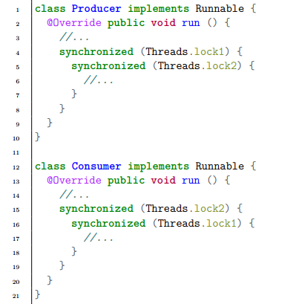
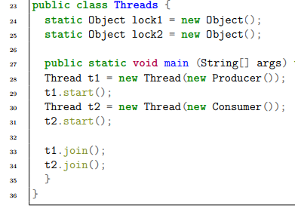
12.1 Issues threading

Slide 4
12.2 Race condition
Q: What is a race condition?

Slide 5
12.2 Race condition
Q: What is a race condition?
A: A race condition occurs when two or more threads try accessing the same shared data at the same time. As you don’t know the order in which Threads run, the program may give undesired results.

Slide 6
12.2
Q: What is meant when a thread is in a critical section (kritischen Abschnitt)?

Slide 7
12.2
Q: What is meant when a thread is in a critical section (kritischen Abschnitt)?
A: A section of the program that access shared resources. Only one Thread should be able to access each shared variable to prevent race conditions. In java, it would be the section between the synchronized blocks.

Slide 8
12.2
Q: What is shared data? What is an example of shared data?

Slide 9
12.2
Q: What is shared data? What is an example of shared data?
A: Shared data is data accessible to multiple threads, in this case target.

Slide 10
12.2
Q: Why does the alternative code work?

Slide 11
12.2
Q: Why does the alternative code work?
A: Join

Slide 12
12.2
Q: How would we use Locks to securely count this program?

Slide 13
12.2
Q: Synchronized vs Locks

Slide 14
12.2
Q: Synchronized vs Locks
A: Lock allows more complex structures whilst synchronized is a rather basic if style block.
Generally, synchronized will be more than enough

Slide 15
12.2
Q: Why is the Secure counter (synchronized incremental) slower than the original.

Slide 16
12.2
Q: Why is the Secure counter (synchronized incremental) slower than the original.
A: Synchronization requires processing power

Slide 17
12.3
I find time would better be spent programing map over 3. I feel that all the concepts taught in 3 are better represented in 4

Slide 18
12.4 Map
A map applies a function on every element of an array and saves it to another array
f : Z → N
[i1, . . . , ik] → [f(i1), . . . , f(ik)]

Slide 19
12.4
Assume the function is very memory intensive that we require multi threading

Slide 20
12.4
Array of length k will be subdivided into n parts
k%n sections shall have the size
Rest have

Slide 21
12.4
Use an interface for a function

Slide 22
12.4
A public class Map that contains the method

Slide 23
12.4
Map shall create n threads
each shall access a sub section of the array
f(a[i]) = b[i] for all valid indices
Make sure your threads are ended

Slide 24
12.4
Write a Function IntToString that implements the interface Fun<Integer, String> to test your program

